Slide 1
ODFW Instream habitat data as part of monitoring under the Oregon Plan for Salmon and Watersheds

Slide 2
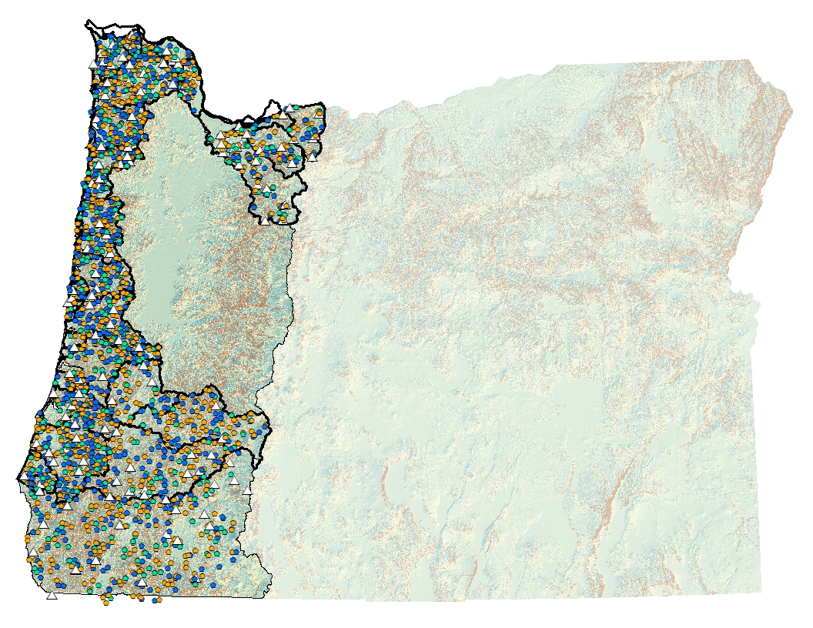
Spatial and Temporal Design
Annual
3-year
9-year
Once
Spatially balanced (GRTS)
Rotating panel: sites sampled at different intervals
Wadeable 1st – 3th Order streams
1998 – 2018 (present)
Lower Columbia
89 sites per year
774 unique sites
Oregon Coast
166 sites per year
1,726 unique sites
South Coast
55 sites per year
643 unique sites

Slide 3
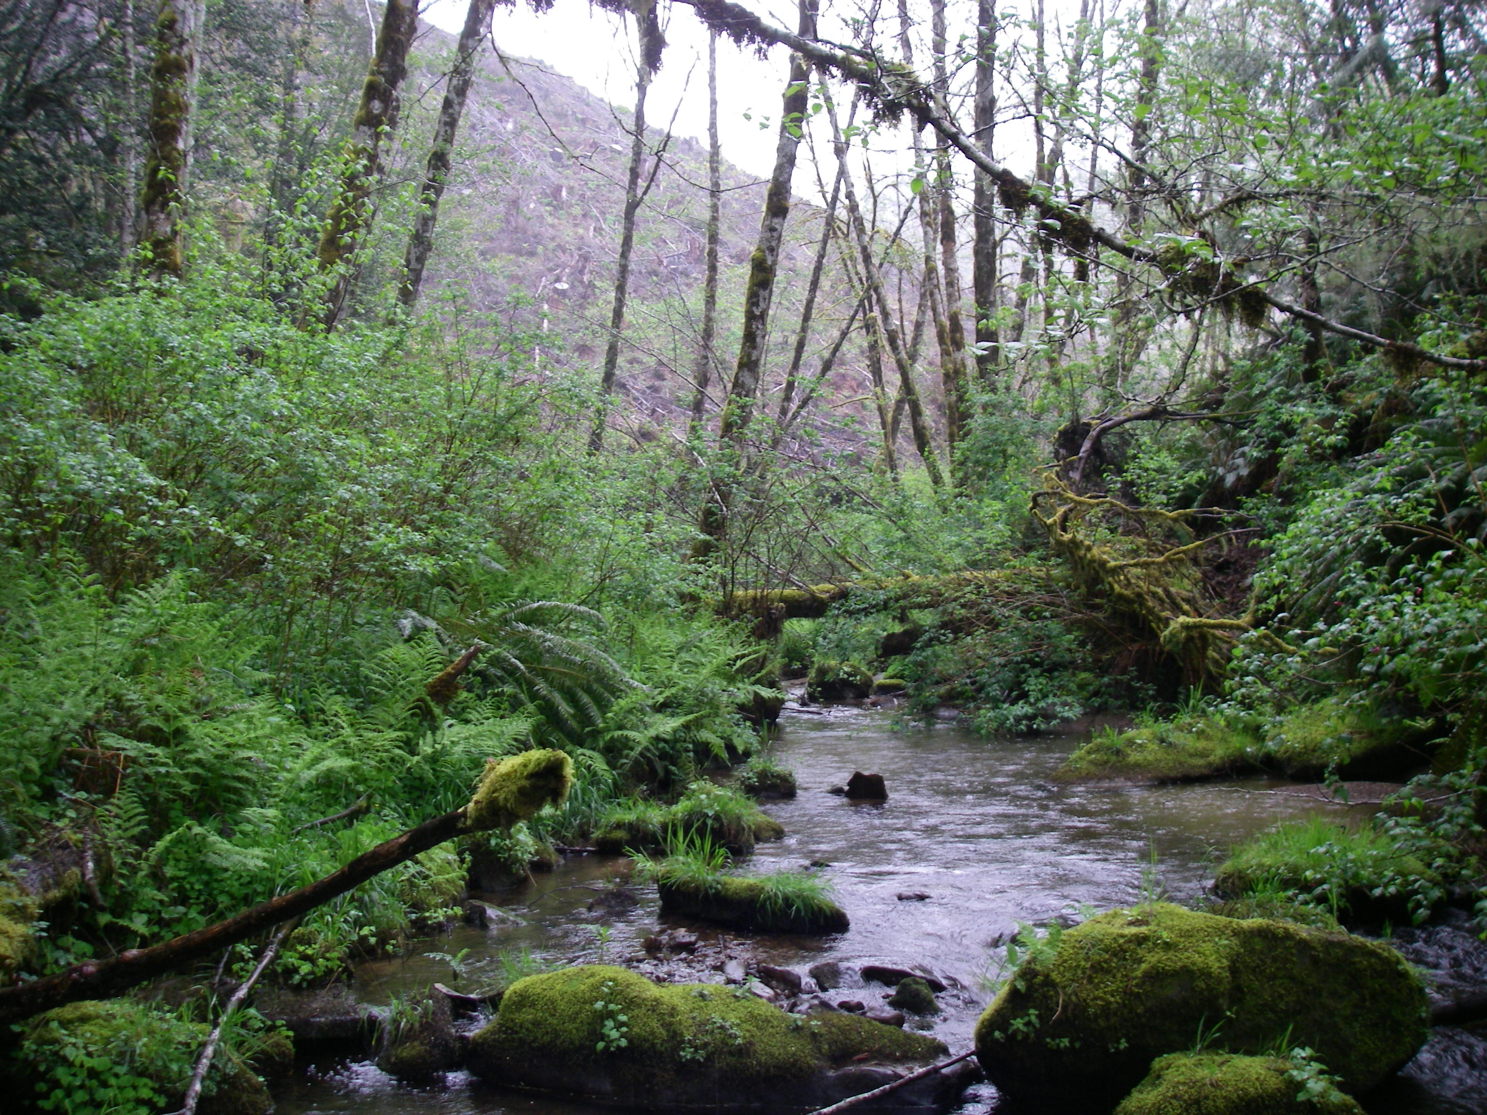
Survey Details
500 m (outside anadromy distribution) or 1,000 m (inside anadromy distribution) reach lengths
Physical habitat
Since 2014, parr quantified in pools at all habitat sites

Slide 4
All Metrics
General survey details | Reach context | Geomorphic channel | Substrate | Wood | In survey observations
Primary channel length | Valley reach index | Number of units per 100 m | Weighted percent sand, organics in riffles | Pieces of large woody debris | Total number of beaver dams
Secondary channel length | Active channel width | Number of habitat units | Weighted percent gravel in riffles | Volume of large woody debris | Total number of signs of beaver activity
Primary channel area | Active channel height | Number of pools | Count of large boulders per 100 meters | Pieces of large wood per 100 meters | Total number of culverts
Secondary channel area | Terrace width | Percent of pools | Weighted percent sand, organics | Volume of large wood per 100 meters | Total number of visible mass failures
Percent secondary channel area | Terrace width | Percent of scour pools | Weighted percent gravel | Number of key pieces | Total number of visible debris jams
Gradient | Flood-prone width | Percent of slack water pools | Weighted percent cobble | Pieces of key large wood (>60 cm X 12 m) per 100 meters | Total number of artificial habitat structures
Wetted width | Flood-prone height | Scour pool depth | Weighted percent boulder
Width:Depth ratio |  | Deep pools per kilometer | Weighted percent bedrock
Percent shading |  | Complex pools, pools with more than 3 pieces of wood
UTM Northing |  | Complex pools per kilometer
UTM Easting |  | Channel width per pool
 |  | Pools per 100 m of reach length
 |  | Residual pool depth
 |  | Riffle depth

Slide 5
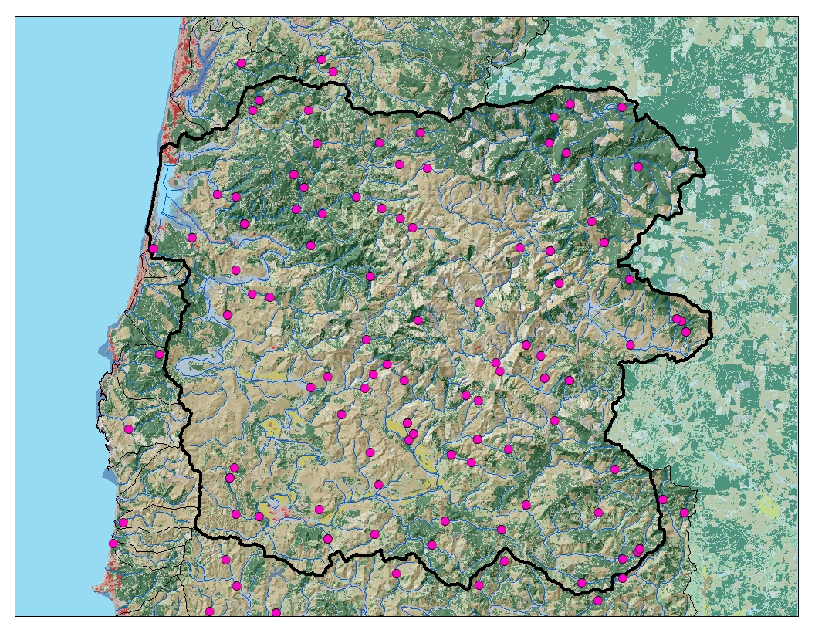
Spatial distribution of sites in Siletz
All Years

Slide 6
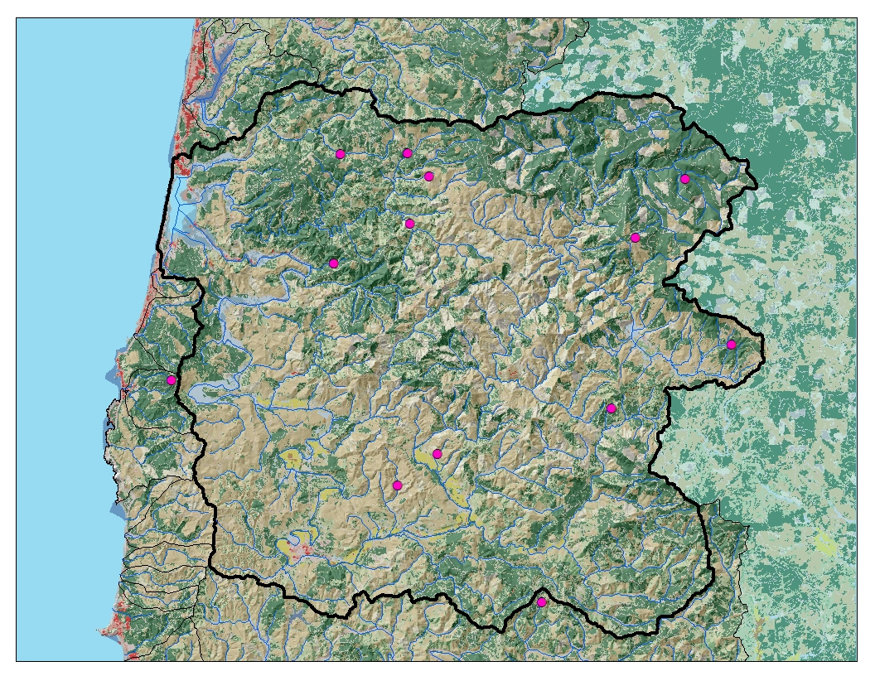
Spatial distribution of sites in Siletz
1998

Slide 7

Spatial distribution of sites in Siletz
2003

Slide 8

Spatial distribution of sites in Siletz
2005

Slide 9

Spatial distribution of sites in Siletz 2010

Slide 10

Spatial distribution of sites in Siletz
2017

Slide 11
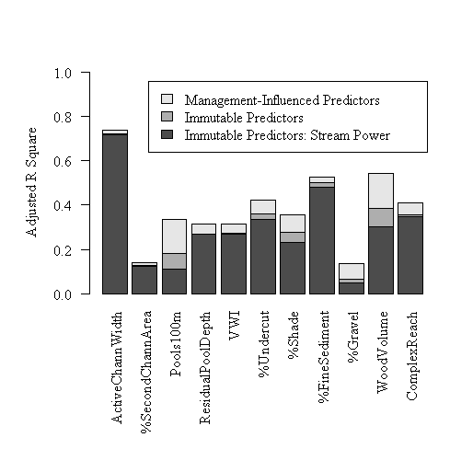
Relationship with different landscape predictors
Anlauf-Dunn et al. 2011

Slide 12
All Metrics Suggested Metrics Highlighted
General survey details | Reach context | Geomorphic channel | Substrate | Wood | In survey observations
Primary channel length | Valley reach index | Number of units per 100 m | Weighted percent sand, organics in riffles | Pieces of large woody debris | Total number of beaver dams
Secondary channel length | Active channel width: ACW | Number of habitat units | Weighted percent gravel in riffles: WGTED_SLOPE_GRAVEL | Volume of large woody debris | Total number of signs of beaver activity
Primary channel area | Active channel height | Number of pools | Count of large boulders per 100 meters | Pieces of large wood per 100 meters | Total number of culverts
Secondary channel area | Terrace width | Percent of pools | Weighted percent sand, organics | Volume of large wood per 100 meters: LWDVOL1 | Total number of visible mass failures
Percent secondary channel area: PCTSCCHNLA | Terrace width | Percent of scour pools | Weighted percent gravel | Number of key pieces | Total number of visible debris jams
Gradient | Flood-prone width | Percent of slack water pools PCTSWPOOL | Weighted percent cobble | Pieces of key large wood (>60 cm X 12 m) per 100 meters | Total number of artificial habitat structures
Wetted width | Flood-prone height | Scour pool depth | Weighted percent boulder
Width:Depth ratio |  | Deep pools per kilometer POOL1P_KM | Weighted percent bedrock WGTED_SLOPE_BEDROCK
Percent channel shade |  | Complex pools, pools with more than 3 pieces of wood
UTM Northing |  | Complex pools per kilometer
UTM Easting |  | Channel width per pool
 |  | Pools per 100 m of reach length: POOLS100
 |  | Residual pool depth
 |  | Riffle depth: RIFFLEDEP

